Slide 1
Semantic-Emotion Neural Network for Emotion Recognition From Text
ERDENEBILEG BATBAATAR
School of Electrical and Computer Engineering, Chungbuk National University, Cheongju 28644, South Korea
MEIJING LI
College of Information Engineering, Shanghai Maritime University, Shanghai 200136, China
KEUN HO RYU
Faculty of Information Technology, Ton Duc Thang University, Ho Chi Minh City 700000, Vietnam
Database and Bioinformatics Laboratory, School of Electrical and Computer Engineering, Chungbuk National University, Cheongju 28644, South Korea
Date of publication : ​August 23, 2019
Presented by:
Aparna Juhi (1806181)
Smriti Pal (1806191)
Sweta (1806157)
Notes:
this is the paper

Slide 2
Dataset
1. Daily dialogs
Details:
This dataset is built on conversations. It contains training, testing and validation dataset. Each dataset have a dialog file and an emotion file.
Dialog file contains the conversation and emotion file contains the corresponding emotion to each dialogue.
Features/Classes:
There are two features for each dataset: dialog and emotion.
The annotation schema follows Ekman and non-emotional sentences.
Ekman’s six emotions are included: 1:anger, 2:disgust, 3: fear, 4:happiness, 5:sadness, 6:surprise and 0:no emotion.

Slide 3
Dataset
2. ISEAR
Details:
This dataset is built on collecting questionnaires answered by people with different cultural backgrounds.
The dataset is divided into training and testing data with ratio of 9:1.
Features/Classes:
The csv file contains two attributes: emotion and text.
The emotions used are joy, fear, anger, sadness, disgust, shame, and guilt. (7 emotions)

Slide 4
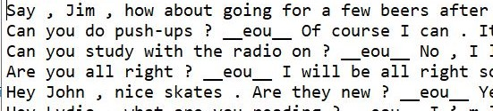
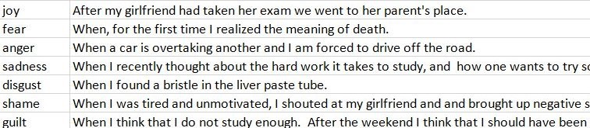

Data Preprocessing
Daily dialog dataset:
“_eou_” is used to separate each sentence.
removed “_eou_” from each dialog after splitting
dialogs tokenizing - each word hold some meaning, thus emotion.
“<pad>” was added to increase number of words to 20.
word embedding using gloVe vector of 50d.
OneHotEncoder applied to emotions with a length of 7.
ISEAR dataset:
removed “no responses” from dataset.
tokenizing text.
“<pad>” was added to increase number of words to 100.
word embedding using gloVe of 300d.
OneHotEncoder applied to emotions with a length of 7.

Slide 5
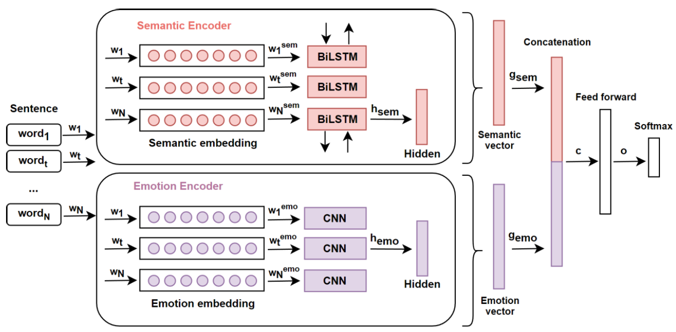
Model implemented - SENN Model

Slide 6
Model implemented
SENN (Semantic Emotional Neural Network) model utilize both semantic and emotional information by adopting existing pre-trained word embeddings.
SENN is divided into two sub-networks. First sub-network uses BiLSTM(bidirectional Long-Short Term Memory) to capture semantic information map into semantic-sentence space.
The second network uses CNN (Convolutional Neural Network) to capture emotional information and map into emotional-sentence space.
Then, both are combined for final representation together.
SENN model outperforms traditional and baseline models.
SENN Model
BiLSTM Model
CNN Model

Slide 7
Training
Input is converted into numpy array so that we can implement SENN Model.
Firstly, three layers of CNN model is used with filters=256, kernel size=3.
Then BiLSTM is used having output units of 128 and a hidden layer of 32 and 7 units.
In between the layer, we have used the Dropout layer of 0.5 to prevent overfitting.
The optimizer used is Adaptive Moment Estimation(Adam)
The loss function used is categorical cross entropy (for multi-class classification).
Batch Size = 128 and Epochs = 20

Slide 8
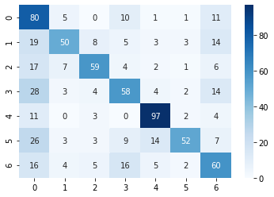
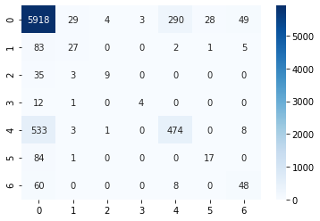
Results
Confusion matrix for ISEAR dataset:
Confusion matrix for Daily dialog dataset:

Slide 9
Results
As predicted in the research paper, the accuracy were 84.3% for Daily dialog dataset and 74.6% for ISEAR dataset.
The accuracy acquired in our model implementation were 83.94% for Daily dialog dataset and 62.66% for ISEAR dataset.
Improvement Areas:
Better accuracy can be achieved with larger and faster emotion word embeddings.

